Slide 1

What’s AWS?
AWS (Amazon Web Services) is a Cloud Provider
They provide you with servers and services that you can use on demand and scale easily
AWS has revolutionized IT over time
AWS powers some of the biggest websites in the world
Amazon.com
Netflix

Slide 2




AWS Cloud History
2002:
Internally launched
2004:
Launched publicly with SQS
2007:
Launched in Europe
2003:
Amazon infrastructure is one of their core strength.
Idea to market
2006:
Re-launched
publicly with SQS, S3 & EC2

Slide 3
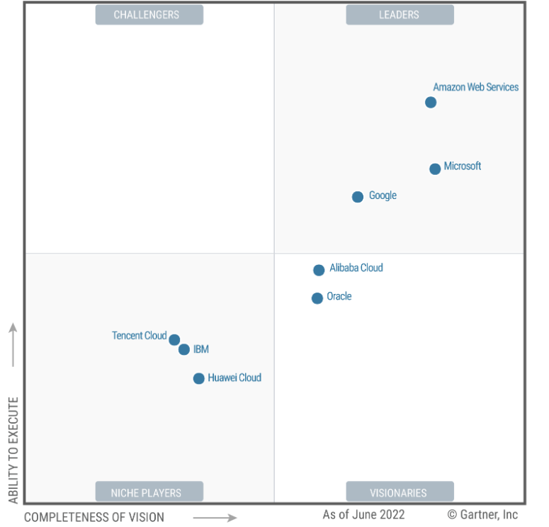

AWS Cloud Number Facts
In 2022, AWS had $62.202 billion in annual revenue
AWS holds 41.5% of the cloud computing market.
Gartner has named AWS Cloud Infrastructure and Platform Services (CIPS) Leader for the 12th consecutive year.
Over 1,000,000 active users
Gartner Magic Quadrant

Slide 4



AWS Cloud Use Cases
AWS enables you to build sophisticated, scalable applications
Applicable to a diverse set of industries
Use cases include
Enterprise IT, Backup & Storage, Big Data analytics
Website hosting, Mobile & Social Apps
Gaming

Slide 5
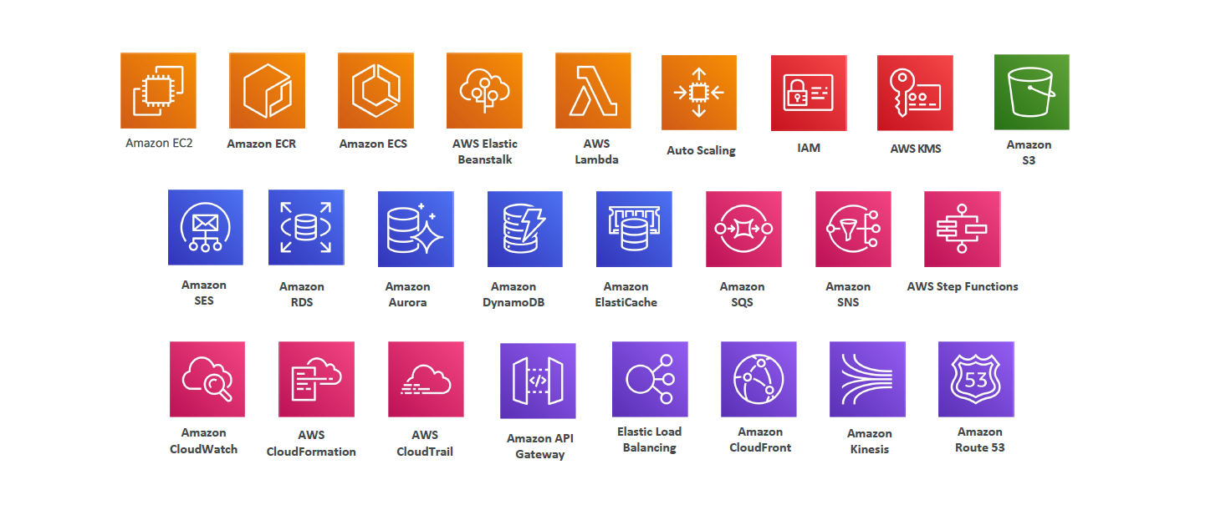
Services offered by Amazon Web Services

Slide 6
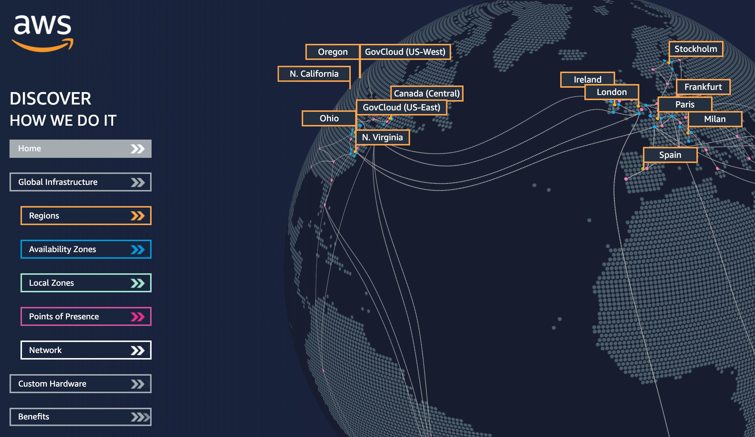
AWS Global Infrastructure
AWS Regions
AWS Availability Zones
AWS Data Centers
AWS Edge Locations
https://infrastructure.aws/

Slide 7
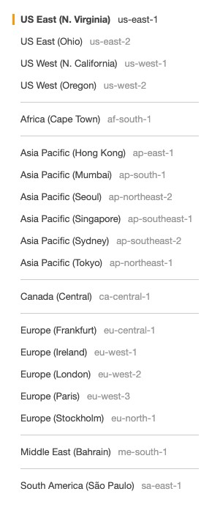
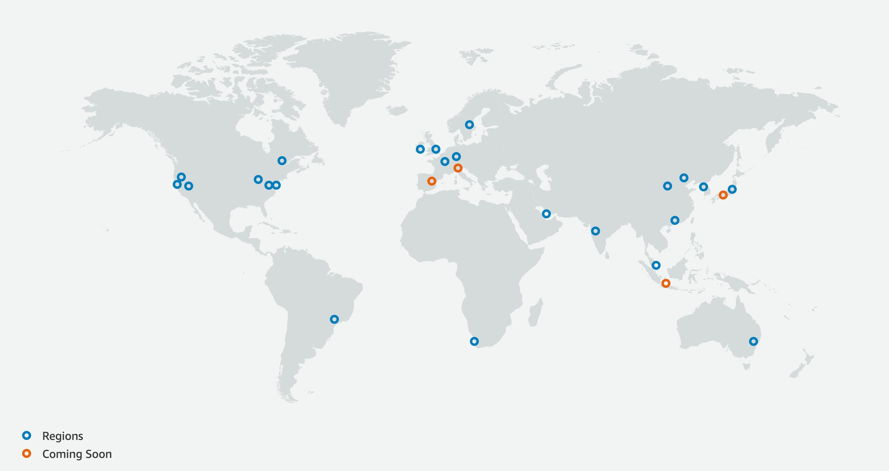
AWS Regions
AWS has Regions all around the world
Names can be us-east-1, eu-west-3…
A region is a cluster of data centers
Most AWS services are region-scoped
https://aws.amazon.com/about-aws/global-infrastructure/

Slide 8


How to choose an AWS Region?
If you need to launch a new application, where should you do it?
Proximity to customers: reduced latency
Available services within a Region: new services and new features aren’t available in every Region
Pricing: pricing varies region to region and is transparent in the service pricing page
?
?
? ?

Slide 9

AWS Availability Zones
Each region has many availability zones (usually 3, min is 2, max is 6). Example:
ap-southeast-2a
ap-southeast-2b
ap-southeast-2c
Each availability zone (AZ) is one or more discrete data centers with redundant power, networking, and connectivity
They’re separate from each other, so that they’re isolated from disasters
They’re connected with high bandwidth, ultra-low latency networking
AWS Region Sydney: ap-southeast-2
ap-southeast-2a
ap-southeast-2b
ap-southeast-2c

Slide 10



Tour of the AWS Console
AWS has Global Services:
Identity and Access Management (IAM)
Route 53 (DNS service)
CloudFront (Content Delivery Network)
WAF (Web Application Firewall)
Most AWS services are Region-scoped:
Amazon EC2 (Infrastructure as a Service)
Elastic Beanstalk (Platform as a Service)
Lambda (Function as a Service)
Rekognition (Software as a Service)
Region Table: https://aws.amazon.com/about-aws/global-infrastructure/regional-product-services

